Slide 1
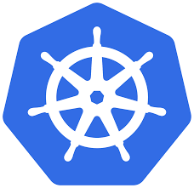
Kubernetes 101:
A short introduction
April, 2020
Suraj Thapa
Prabesh Thapa

Slide 2
TL;DR;
This is an introductory workshop on kubernetes, which will help attendees gain basic information about container, docker, kubernetes, using kubernetes in AWS.

Slide 3
Topics
Containers (what, why, when, how)
Docker (docker engine, compose, swarm)
Black box introduction on kubernetes
Kubernetes on AWS

Slide 4

So WTF is a Container ?

Slide 5
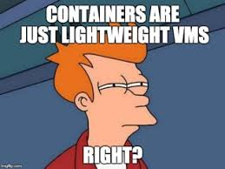
A container is
Container is a basically a process (with PID) just like any other process running in our system with its own sets of configuration.
Container provides a computing environment to run application along with its dependencies.
Having said this, container does the same thing as VM. So, does this mean we can call containers as LW VM?
Answer is YES.
Source: https://www.docker.com/resources/what-container

Slide 6

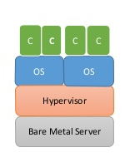

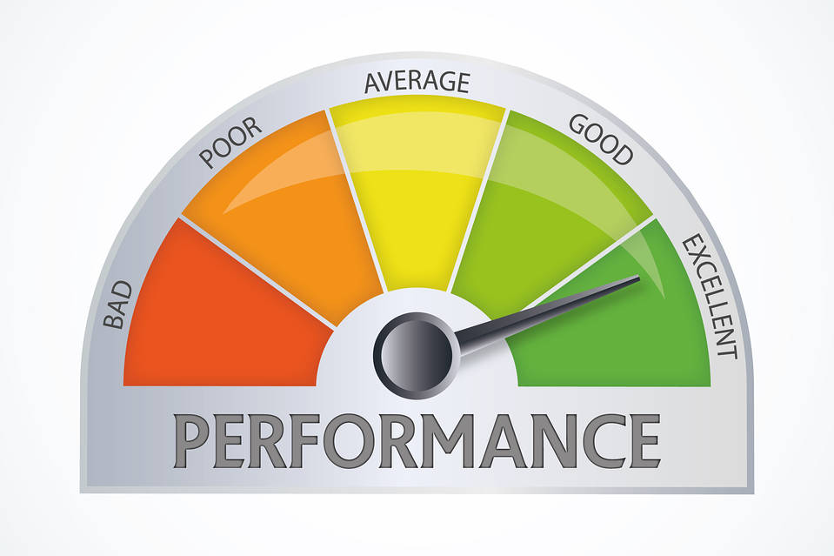
Why containers?
Lightweight
Performance
Shared host
OS level virtualization

Slide 7



And we have more benefits..
Less space
Scaling
Faster provisioning

Slide 8
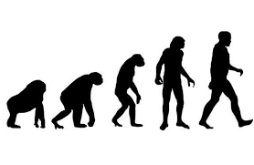
When
Containers existed long before, back then they were not called containers.
So let’s have a quick recap of container evolution.

Slide 9


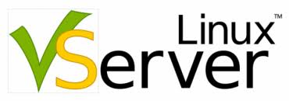


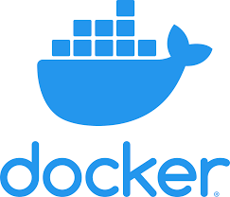

Timeline
(2001)
Linux-V Server
Kernel isolation
feature
(2004)
Solaris
Introduces zones
Using spanshot
(2006)
Introduces cgroups (process + containers)
(2008)
Introduces user namespaces to limit access
(2000)
FreeBSD
developed jails
(Uses chroot)
(2008)
Created LXC
cgroups + namespaces

Slide 10
Docker
There has been a lot of misunderstanding regarding docker and container.
Docker is a tool to run containers.
It helps users to run, deploy, manage containers.
Packages applications along with its dependencies into isolated processes with the use of cgroups and namespaces. (This will be explained in next slide)
Helps to provide OS level virtualisation.

Slide 11
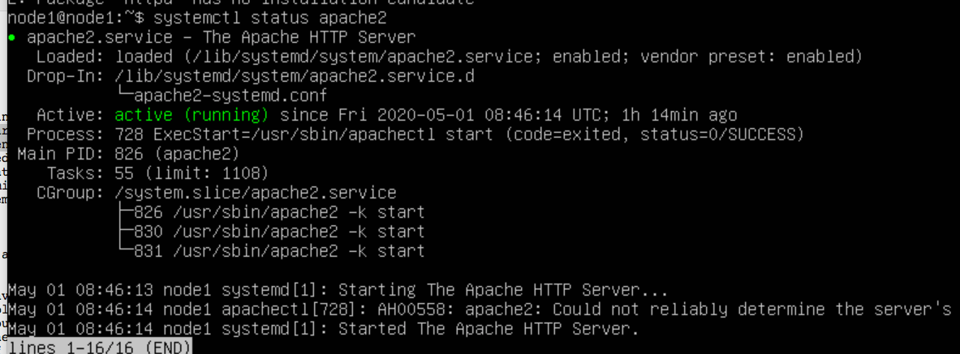
Cgroups (Control groups)
Cgroups: Control groups often known as cgroups is a kernel feature of linux which helps to limit accounts for CPU, memory, disk I/O , network usage and more. This feature allows processes to be organized into hierarchical groups whose usage of various types of resources can then be limited and monitored.It provides features like:
Resource limiting
Prioritisation
Accounting
Control

Slide 12
Namespace
Namespace is a feature of linux kernel which allows process isolation.
Namespace makes it appear to the processes within the namespace that they have their own isolated instance of the global resource.
There are different types of namespaces like PID, Mount, IPC, TIME, User, UTS, Network
One of the main use case of namespace is to implement containers.
Can be viewed inside “/proc/{PID}/$$/ns/”

Slide 13
Docker Engine, Compose, Swarm
Docker Engine: It is client-server technology which allows us to run containers across multiple platforms. It helps to run a container.
Docker Compose: It is a tool inside docker engine, which helps us to run multi-container application’s services in a single node (host).
Docker Swarm: It is groups of hosts running docker containers which have been configured to run as a cluster. Docker swarm is a container orchestration tool which means it helps to manage multiple containers deployed across multiple host machine in master – worker configuration.

Slide 14
So now,
What is kubernetes ?

Slide 15
Overview
Kubernetes is a container orchestration tool.
Kubernetes is an open-source container-orchestration system for automating application deployment, scaling, and management. It was originally designed by Google, and is now maintained by the Cloud Native Computing Foundation.
It is also written as k8s.

Slide 16

So, what is the difference between docker swarm and kubernetes ?

Slide 17
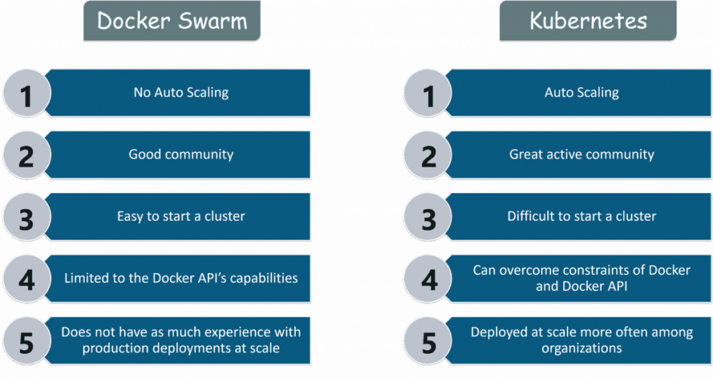
Docker swarm vs Kubernetes

Slide 18
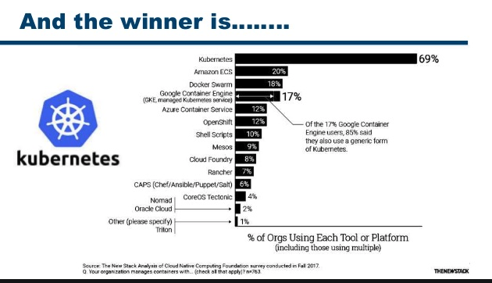
Why k8s won ???
Multi-host container scheduling
Scalability and availability.
Flexibility and modulations
Registration and service discovery
Persistent storage
Application upgrades and downgrades
Backward compatible
Logging and monitoring
Secret management
Community support

Slide 19
kubectl
Worker Node
Master Node
kubelet
kube-proxy
Kube config
API Server
Pods
pods
Scheduler
contolller
Internet
Etcd database
Worker Node
kubelet
kube-proxy
Pods
Pods

Slide 20

Time for some Theories

Slide 21
k8s Components
Control plane (Master Node)
API server
Controller Manager
Scheduler
Etcd
Worker Node
Kubelet
Kube-proxy
Container runtime (docker)

Slide 22
Master Node (Control Plane)
It is responsible for overall management of k8s cluster.
3 components :
Communication (Kube API server)
Interaction between kubernetes API endpoints.
Done by kube API server
Scheduling (Scheduler)
Watches pods created which do not have node design yet.
Designs pods to run on a specific node.
Controller (Control manager)
Runs various controller to which in turn are responsible for various jobs.
Example Node controller handles node state, replication controller handles correct number of pods
Endpoint controller joins services and pods togerther etc.

Slide 23
ETCd
It is a distributed key-value (similar to JSON) data storage in k8s.
It uses etcd as database and stores data here like jobs scheduled info, pod details, stage info etc.

Slide 24
kubectl
It is a command line interface for k8s to interact with master node.
Configuration for kubectl is stored in kubeconfig
Kubeconfig:
Container configuration about server
Authentication information to access k8s API.

Slide 25
Worker Node
It is the node where application is operates.
Worker node uses docker engine to run containers.
Contains 4 components
Kubelet
Communicates with master, mounts pods volume, runs pods via container runtime
Kube-proxy
Works as network proxy and load balancer, routing, connection forwarding if pods want to communicate to public internet.
Container runtime (docker engine)
It used docker engine to run containers, we do not manage this.
Pods (containers)
It is the smallest unit that can be created in k8s, create, delete, deploy pods
Contains docker container, storage resource, unique IP, configuration that governs how container should run.

Slide 26
More on pods...
Smallest unit in k8s.
Single instance of application in k8s tightly coupled.
Ephemeral and disposable, hence never create pods by themselves.
Use controller to run pods

Slide 27
Possibly in next session
Pod states
Replica set
Types of controllers
Types of network services
Labels, selection and namespaces

Slide 28


